Slide 2
DNA
and
RNA
Recipes for Protein

Slide 3
Genetics ~ The study of heredity.
DNA ~ Deoxyribonucleic acid.
DNA contains codes for
making cell proteins.
Gene ~ One of the individual protein
codes on DNA. The genes on DNA can vary from one individual to another.

Slide 4
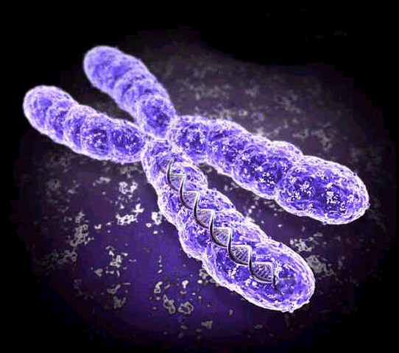
DNA in the Nucleus
Chromatin ~ DNA coated in protective proteins.
Chromosome ~ Chromatin that has been copied and coiled up into an X shape to prepare for cell division.
Parts of a chromosome:
Histones
Centromere
Sister Chromatids / daughter chromosomes

Slide 5
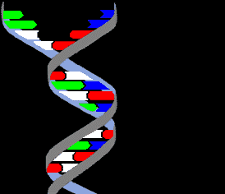
The Structure of DNA
Double Helix ~ DNA is shaped like a twisted ladder. The ladder is made up of nucleotides.
Nucleotide ~ One of the units that form the DNA ladder. Each nucleotide is made up of three parts:
1. Phosphate (PO₄)
2. Deoxyribose sugar
3. Nitrogen base
Base Pairs ~ The nitrogen bases always match up the same way:
Adenine – Thymine
Guanine – Cytosine

Slide 6
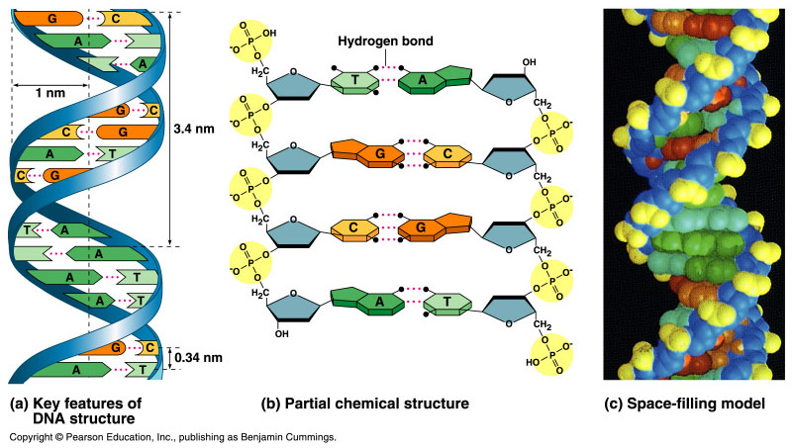
A sample of DNA is found to contain 15% adenine. What would the percentage of thymine be? Cytosine? Guanine?

Slide 7
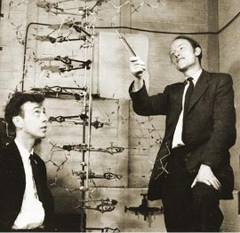
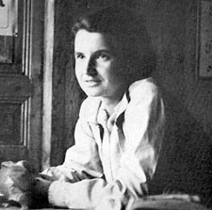
Race to Discover the Double Helix
Crick & Watson ~ 1953
They publish their findings in Nature. They win the Nobel Prize in 1962
Rosalind Franklin ~ Worked with DNA and X-Ray crystallography. Her pictures supplied Crick & Watson with their proof. She died in 1958.

Slide 8
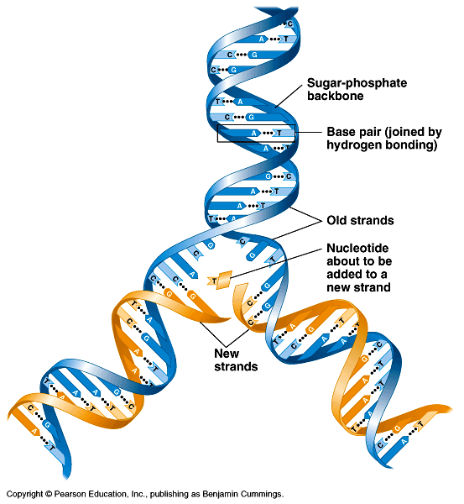
Replication ~ Process by which two full new strands of DNA are made.
Enzymes in the nucleus unzip the base pairs.
Loose nucleotides match up with the exposed bases on each half of the unzipped DNA.
Enzymes bond the new nucleotides in place, forming two full copies of DNA.
Copying DNA

Slide 9
DNA Replication (copying)
Step 1: Original DNA is unzipped.
Step 2: New nucleotides match up with both sides of the unzipped DNA.
Step 3: When all the nucleotides have matched up, there are two complete sets of DNA. Each is half of an old strand and half of a new strand.

Slide 10
Theories of Replication
Conservative theory ~ Idea that replication produces one entirely new strand of DNA, and the original strand stays intact. Proven incorrect in 1957.
Semi-conservative theory ~ Idea that replication produces two new DNA strands, each is made of half the original DNA and half newly assembled nucleotides.
Proposed by Crick and Watson
Accepted theory today.

Slide 11
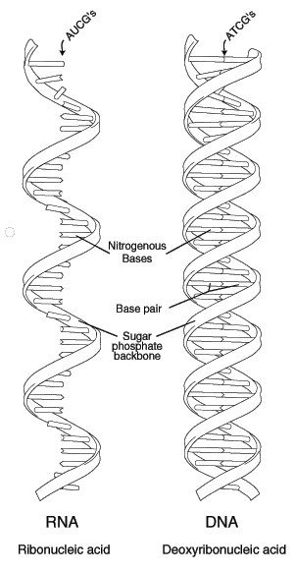
The structure of RNA
Phosphate
Ribose sugar
Nitrogen base:
Adenine-Uracil
Guanine-Cytosine

Slide 12
Differences between DNA and RNA
DNA
Double strand
Deoxyribose sugar
Thymine pairs with adenine
Complete set of gene codes
Made by replication
RNA
Single strand
Ribose sugar
Uracil pairs with adenine
One gene code
Made by transcription

Slide 13
Types of RNA
Messenger RNA (mRNA)
Transfer RNA (tRNA)
Ribosomal RNA (rRNA)

Slide 14
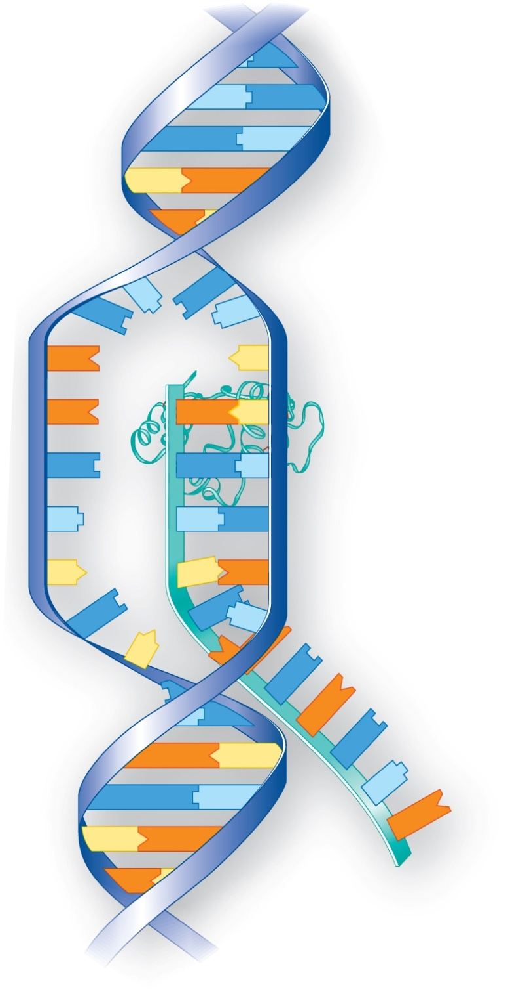
Copying Genes & Making RNA
G
C
G
G
C
Transcription ~ The process by which one gene code on DNA is copied.
Messenger RNA (mRNA) ~ The copy of the gene code made by transcription. mRNA will leave the nucleus, and be used by a ribosome to make a protein.
template
DNA
strand
C
G
C
G
3′
RNA
polymerase
G
G
C
C
C
G
T
U
A
G
G
C
T
G
G
G
G
C
C
mRNA
5′
to processing

Slide 15
Central Dogma
The basic method of reading and expressing genes:
Information passes from the DNA to an RNA copy of the gene, and the RNA copy directs the production of an amino acid chain.
DNA → RNA → Protein

Slide 16
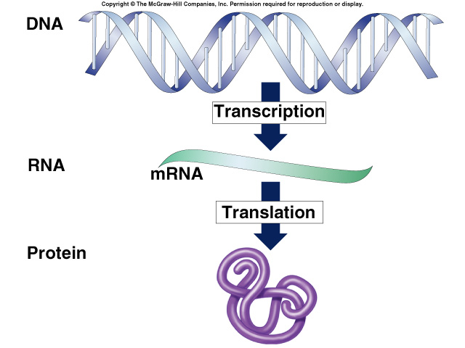

Slide 17
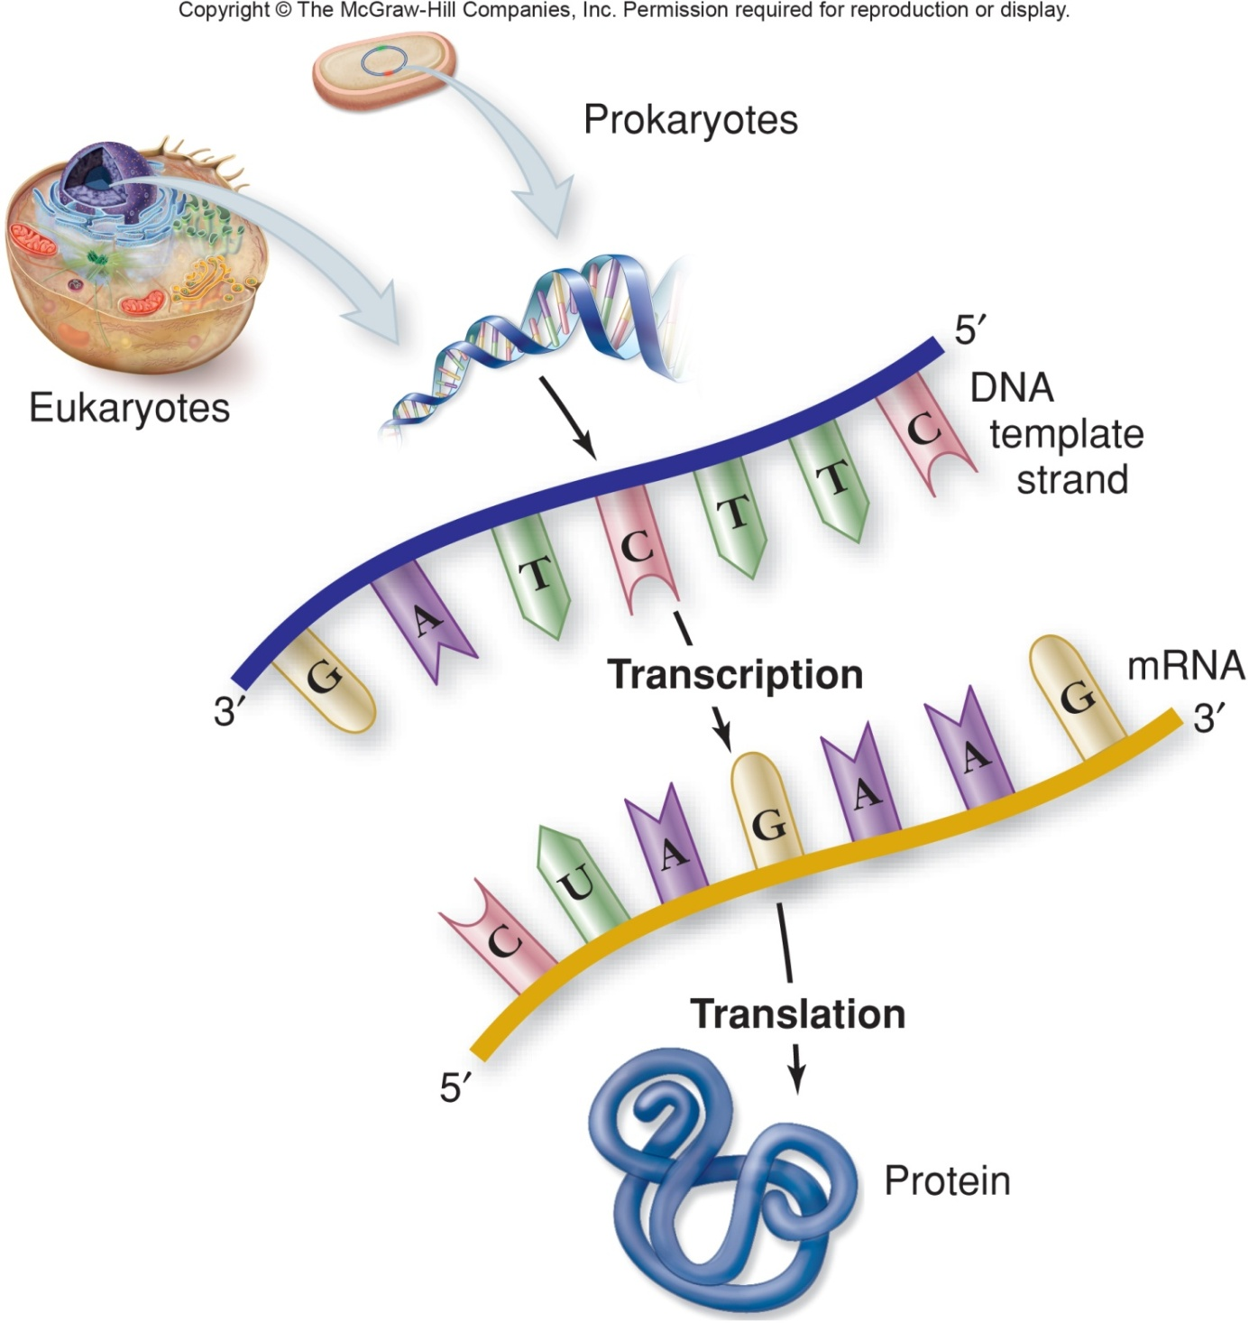

Slide 18
Translation (Protein Synthesis)
Ribosome receives mRNA.
Transfer RNA (tRNA) anticodon matches up with the “start” codon on mRNA, then goes to “fetch” the correct amino acid.
The ribosome receives the amino acids and bonds them together in order with peptide bonds.
The “stop” codon on mRNA is reached, and the protein is finished.

Slide 19
Codons
Codon ~ Three bases that form a code for an amino acid. Found on mRNA.
Start codon ~ Always AUG, which is the codon for methionine.
Stop codon ~ See chart. These are nonsense codons for which there is no amino acid. There is nothing for tRNA to “fetch”, so protein synthesis stops.
Anticodon ~ Three bases on tRNA that match up with codons.
Amino acid ~ One of the building blocks of a protein. The order of amino acids determines the type of protein.

Slide 20
Protein Synthesis

Slide 21
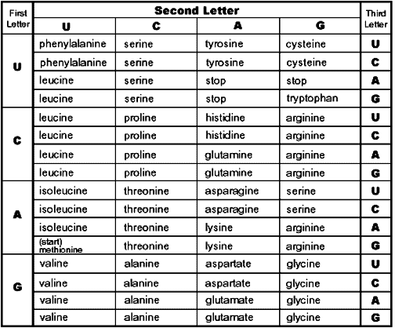
Codon Chart for Amino Acids

Slide 22
Put it together!
DNA Sequence:
TAC | TTC | GCT | ATA | CCC | ATC
mRNA codons:
AUG |  |  |  |  | UAG
tRNA anticodons:
UAC
Amino acids:
Methionine

Slide 23
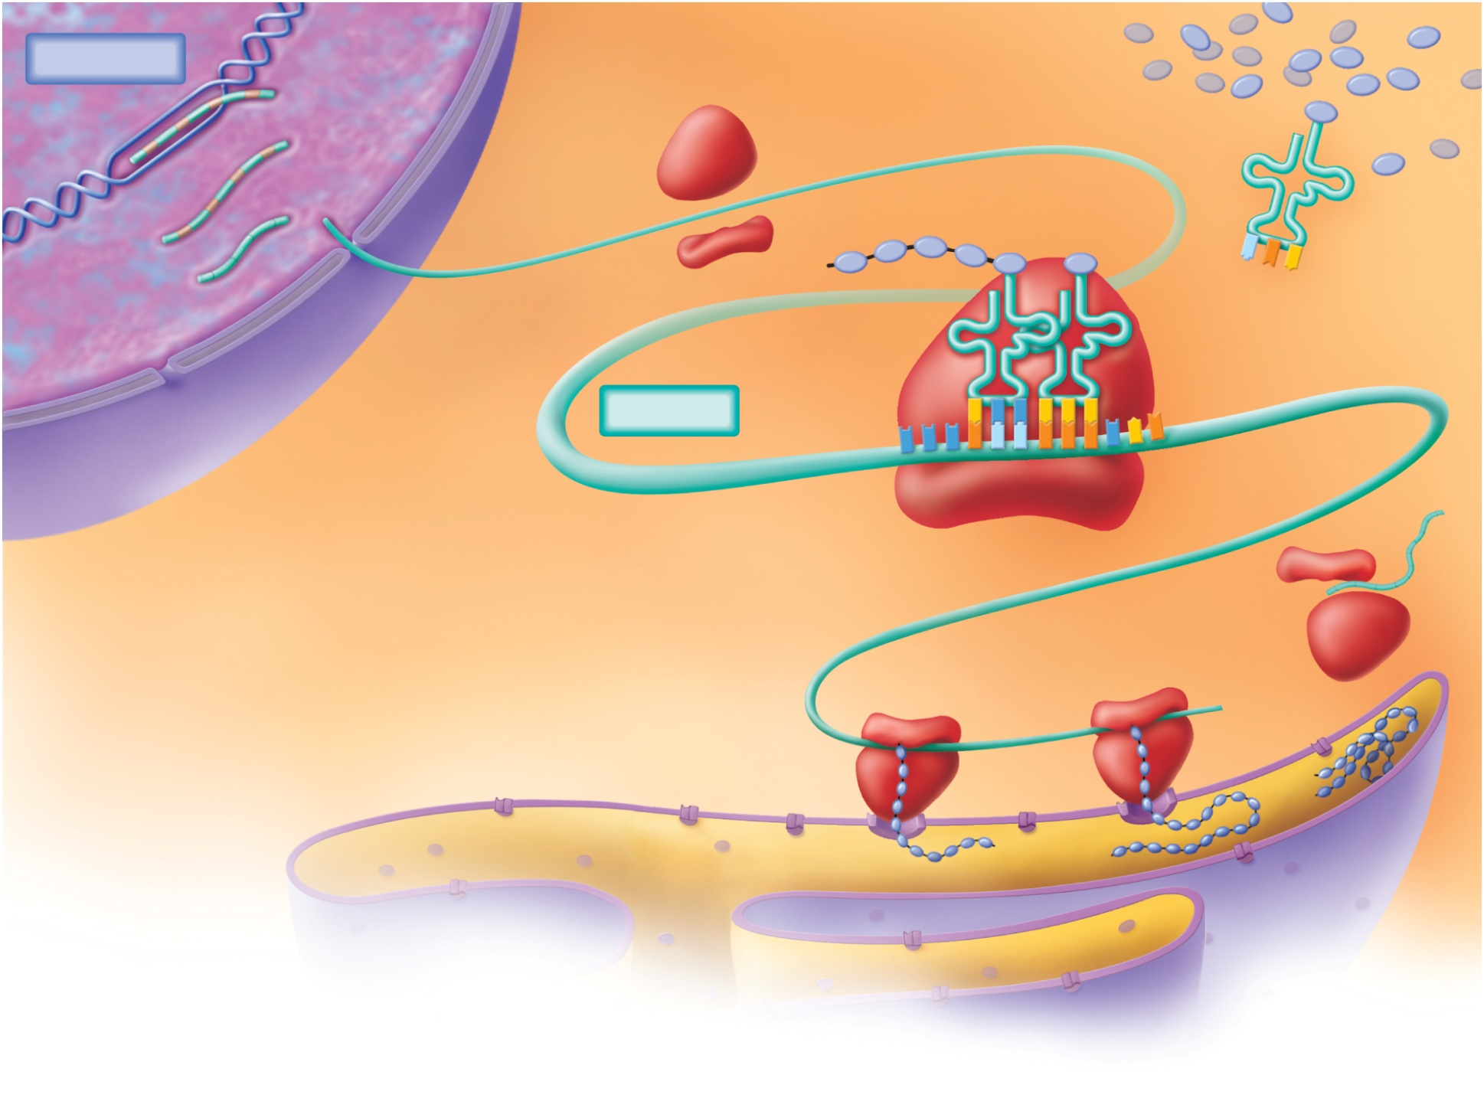
Transcription
1. DNA in nucleus
serves as a template.
2. Pre-mRNA is
processed
before leaving
the nucleus.
3. mRNA moves into
cytoplasm and becomes
associated with
ribosomes.
amino
acids
DNA
large and small
ribosomal subunits
introns
peptide
tRNA
4. tRNAs with
anticodons
carry amino
acids to mRNA.
primary
mRNA
mature
mRNA
6. Polypeptide
synthesis takes
place one amino
acid at a time.
anticodon
mRNA
5. Anticodon–codon
complementary base
pairing occurs.
Translation
ribosome
codon
8. At termination, the
ribosome detaches from
the ER; ribosomal subunits
and the mRNA dissociate.
7. When a ribosome
attaches to rough ER,
the polypeptide enters
its lumen, where the
polypeptide folds and
is modified further.

Slide 24
Mutations
A mutation is a mistake in the DNA sequence.
Most mutations are harmless, and cause no change in function.
Changes in DNA can lead to changes in protein shape, affecting function.
Mutations can cause overproduction or underproduction of proteins, which can cause disease.

Slide 25
Point Mutation
One letter is changed.
Changes mRNA codon
Changes amino acid or is “silent”
Changes protein – it will be the wrong shape.
Example: Sickle-cell anemia

Slide 26
Frameshift Mutation
Frameshift Mutation ~ A letter or sequence of letters is added OR deleted. This changes the entire DNA sequence after the added/deleted letter.
Changes all of the mRNA codons after the mistake.
Changes all the amino acids
Changes the entire protein.
Example: Gene for high cholesterol, heart arrhythmia, Tay-Sach’s disease.

Slide 27
Two Types of Frameshift Mutation
GATTACAACATTAG
Insertion | Deletion
GATTACATACATTAG | GATTACACATTAG

Slide 28
Gene Regulation
Gene Regulation ~ Process of turning genes “on” or “off”.
Genes can be regulated by:
Temperature
Hormones
Presence of correct substrate.

Slide 29
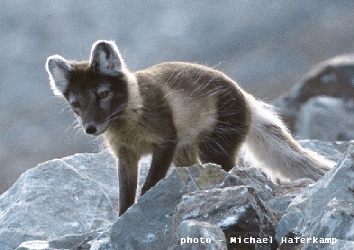
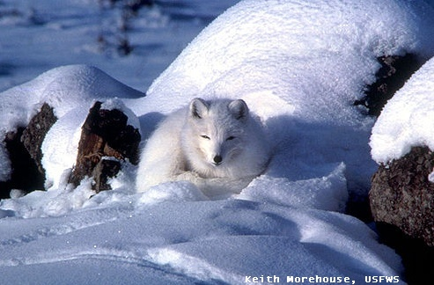
Arctic Foxes

Slide 30
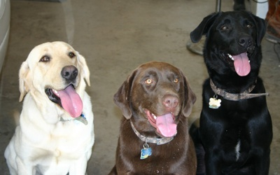
Yellow, Chocolate and Black Labs

Slide 31
Cell Specialization
Most of an organism’s cells have the same DNA but differ based on the expression of genes
Gene regulation allows for cell specialization by increasing the versatility and adaptability of an organism by allowing the cell to express proteins when needed

Slide 32
Cell Specialization
Cell specialization- cells are tailored to specific jobs in tissues and organs.
Stem cell- cell that can become any type of cell (all of its genes can potentially be used)
Differentiation- shaping of a cell into a particular type of cell by the selective switching of genes.

Slide 33
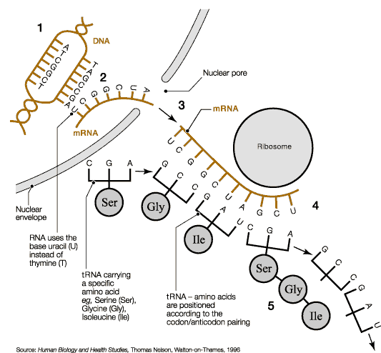

Slide 34
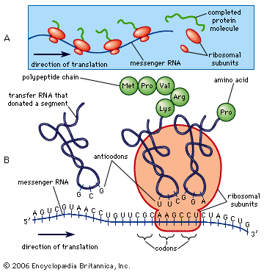

Slide 35
