Slide 1
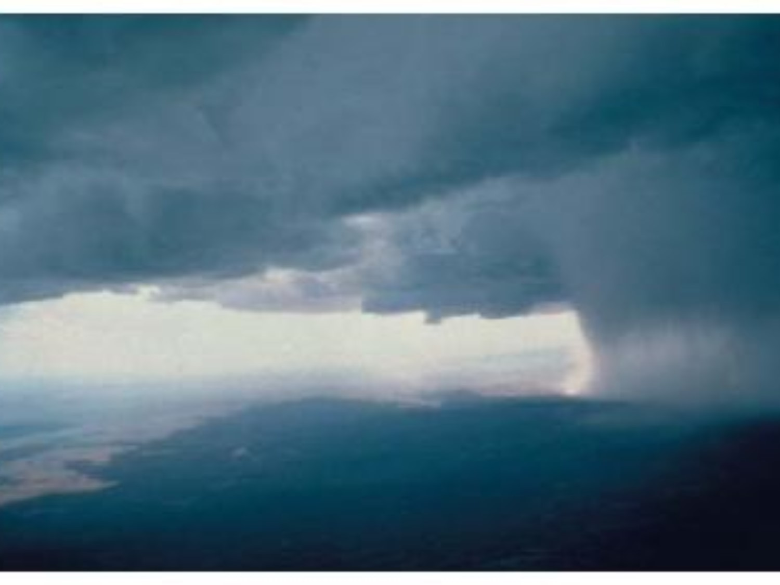
Air Masses, Fronts

Slide 2
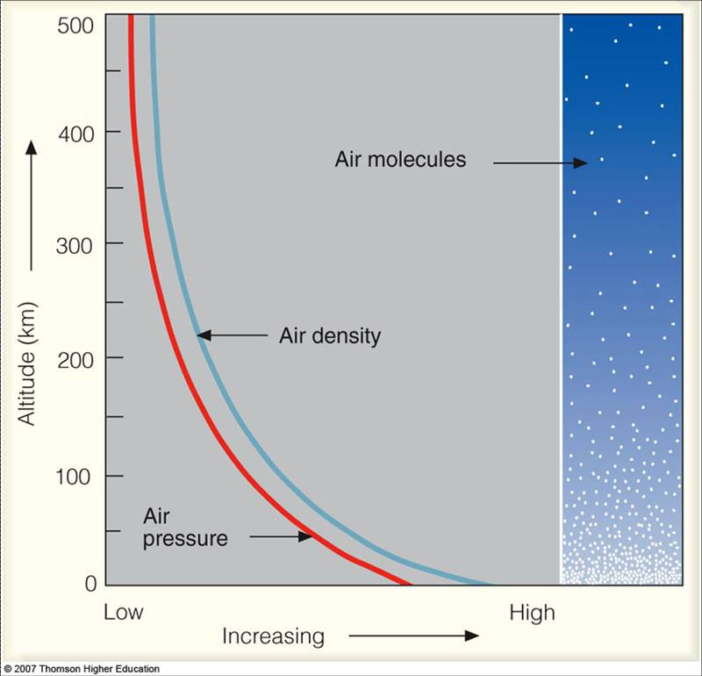
Air Density
Air Density is the amount of air contained in a specific volume
Factors that affect air density:
Temperature-As temperature goes up, air density goes down
Air Pressure-Air density increases with increase pressure
Altitude-As altitude increases, air pressure decreases as does density
Humidity-The more moisture in the air the lower the air density

Slide 3
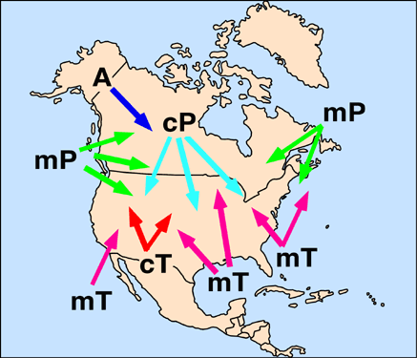
Air Masses
An air mass is a large body of air that takes on the characteristics of the area over which it forms
Continental Tropical (cT)
Maritime Tropical (mT)
Continental Polar (cP)
Maritime Polar (mP)
Arctic (A)

Slide 4
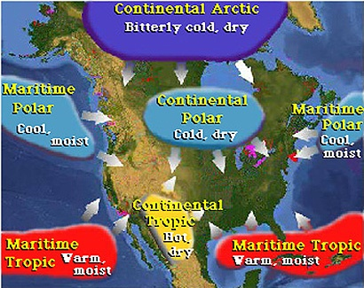

Slide 5
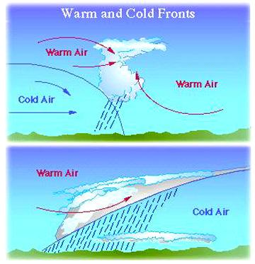
Air Masses
Air masses move when they encounter a pressure difference with a surrounding air mass
When air masses meet generally severe weather occurs (Hurricanes, tornadoes)

Slide 6
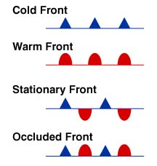
Fronts
A front is a narrow region separating two air masses of different densities
Cold Front
Warm Front
Stationary Front
Occluded Front

Slide 7
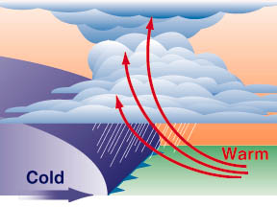
Cold Front
In a cold front cold, dense air displaces warm air and forces the warm air up. As warm air rises it cools and condenses
Clouds, showers and thunderstorms are often associated with cold fronts

Slide 8
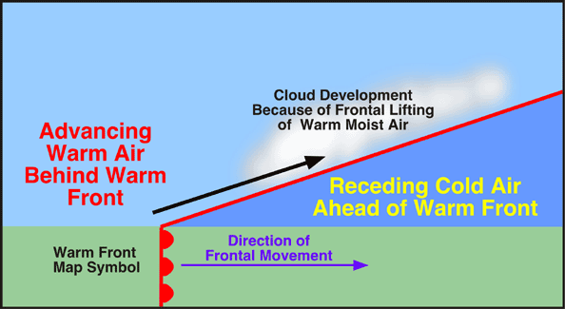
Warm Front
In a warm front warm air displaces cold air
A warm front is characterized by extensive cloudiness and precipitation

Slide 9
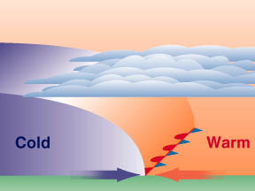
Stationary Front
In a stationary front two air masses meet and neither advances
There are rarely any clouds or heavy precipitation

Slide 10
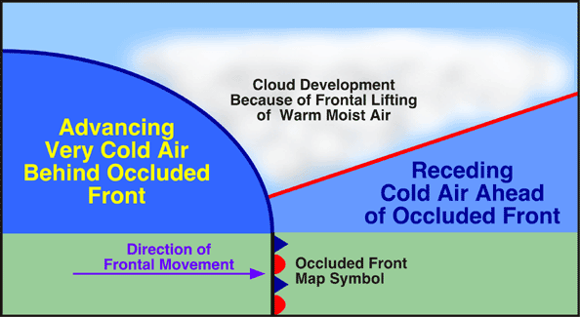
Occluded Front
An occluded front occurs when a cold air mass moves so quickly that it overtakes a warm front.
The warm air is wedged upward

Slide 11
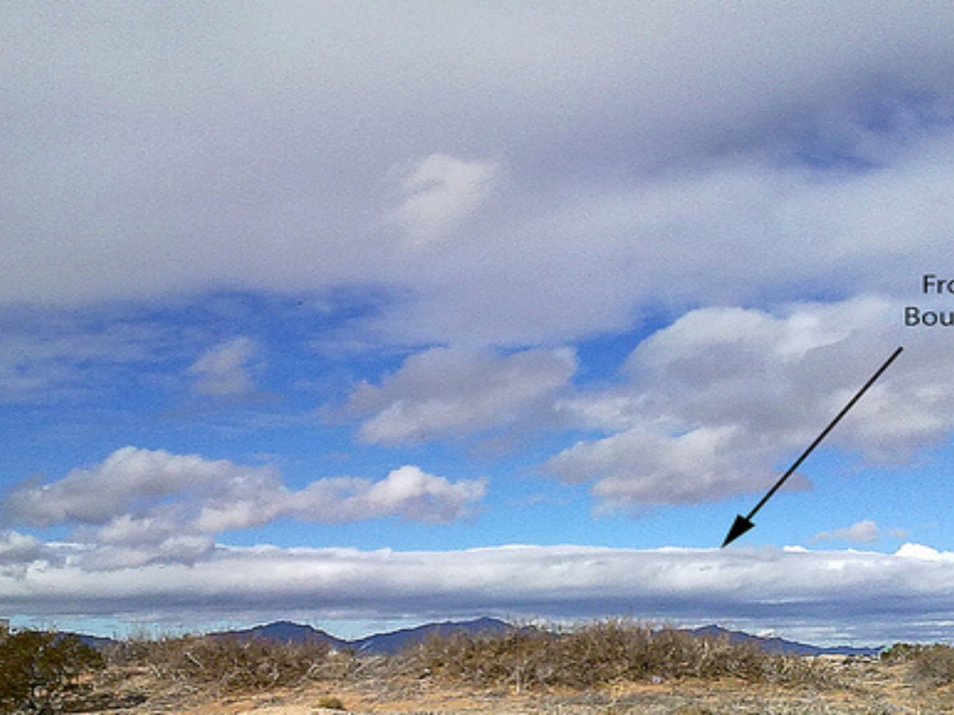
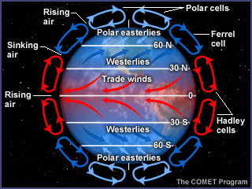
Wind Systems
Wind occurs due to a pressure/tempreature difference between 2 air masses
There are 3 zones of winds systems in each hemisphere caused by the Coriolis Effect
Trade Winds (Located 0-30 N and S). Blows East-West
Prevailing Westerlies (Located 30-60 N and S) Blows West-East
Polar Easterlies (Located 60-90 N and S) Blows East-West)

Slide 12
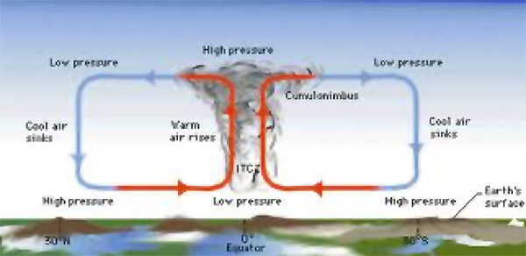

Slide 13
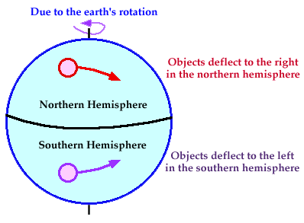

Slide 14
